Slide 1
MIXTURES AND SOLUTIONS

Slide 2
WHAT IS A MIXTURE? https://www.youtube.com/watch?v=UWwM71SNpJ8
A mixture is a substance made of two or more materials that can be in different state, that do not react with each other, so they can be separated by physical means. Each substance makes up a phase. A phase is related to the state of the material.
SUBSTANCE 1
SUBSTANCE 2

Slide 3
KINDS OF MIXTURES
HOMOGENEOUS
Components are uniformly distributed forming one phase.
HETEROGENEOUS
Components are in different phases.
Soft drinks, alloys
Soil, salad

Slide 4
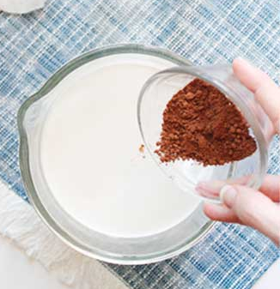
HOMOGENEOUS MIXTURES ARE CALLED SOLUTIONS
Mixtures in which matter is mixed evenly in one phase are called solutions.
Solutions are made of two parts:
The solute: The substance that is dissolved.
The solvent: The mean or matrix in which the solute is dissolved.

Slide 5
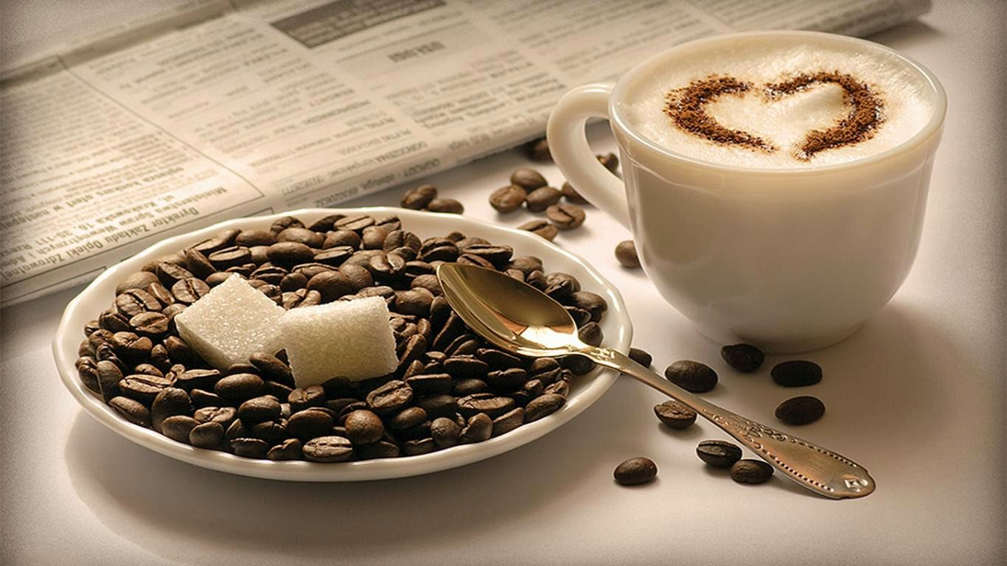
Solubility is the ability of a substance to dissolve into another at a given temperature.
Usually, there is more solvent than solute within a solution.
The amount of solute in a given amount of solvent is called concentration.

Slide 6
KINDS OF SOLUTIONS
GAS-GAS | AIR
GAS-LIQUID | SOFT DRINKS, VAPOR
GAS-SOLID | SMOKE
LIQUID-LIQUID | ALCOHOLIC BEVERAGES
LIQUID-SOLID | SALTY WATER
SOLID-SOLID | METAL ALLOYS

Slide 7
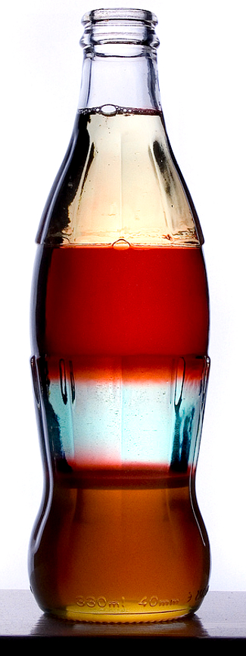
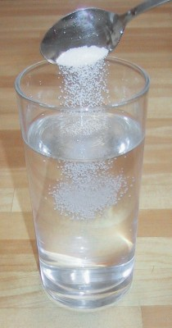
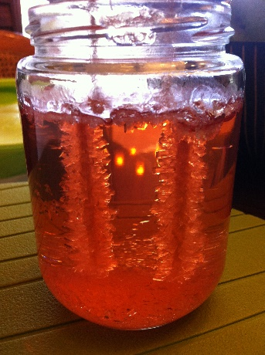
SUBSTANCES THAT DISSOLVE EACH OTHER ARE CALLED MISCIBLE.
SOLIDS DISSOLVE ON LIQUIDS WHEN THE SOLVENT IS ABLE TO OVERCOME THE ATTRACTION FORCES OF THE PARTICLES OF THE SOLID.
A SOLUTION IS SATURATED WHEN A SOLUTION HAS THE MAXIMUM AMOUNT OF A SOLUTE DISSOLVED IN IT.

Slide 8
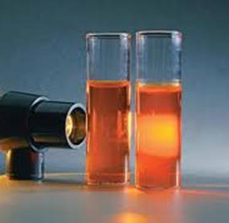
COLLOIDS
A colloid is a mixture in which the particles are not large enough to settle out, and are evenly distributed within the solvent. Colloids don’t let the light pass through their particles. Instead, light is scattered. (Tyndall effect)

Slide 9

Why is the sky blue?
Blue light has the shortest wavelength in the visible light spectrum, while red has one of the longest. Light with shorter wavelengths scatters more so than longer wavelengths. Thus, the sky looks blue when viewed away from the sun: the blue light is scattered more and is visible to a greater extent.

Slide 10
TYPES OF COLLOIDS
NAME | DISPERSED PHASE | DISPERSED MEDIUM | EXAMPLES
SOL | SOLID | LIQUID | PAINT, FRUIT JELLY, GEL, DYE
EMULSION | LIQUID | LIQUID | MAYONNAISE, MILK, SALAD, CREAM
FOAM | GAS | LIQUID | SOAP SUDS, WHIPPED CREAM, BEER FROTH
SOLID SOL | SOLID | SOLID | ALLOYS, GEMSTONES, RUBY, GLASS
SOLID EMULSION | LIQUID | SOLID | BUTTER, CHEESE
SOLID FOAM | GAS | SOLID | PUMICE, MARSHMALLOW, MERINGUE
SOLID AEROSOL | SOLID | GAS | SMOKE, DUST IN AIR, BACTERIA IN AIR
LIQUID AEROSOL | LIQUID | GAS | FOG, MIST, CLOUD, SPRAYS

Slide 11
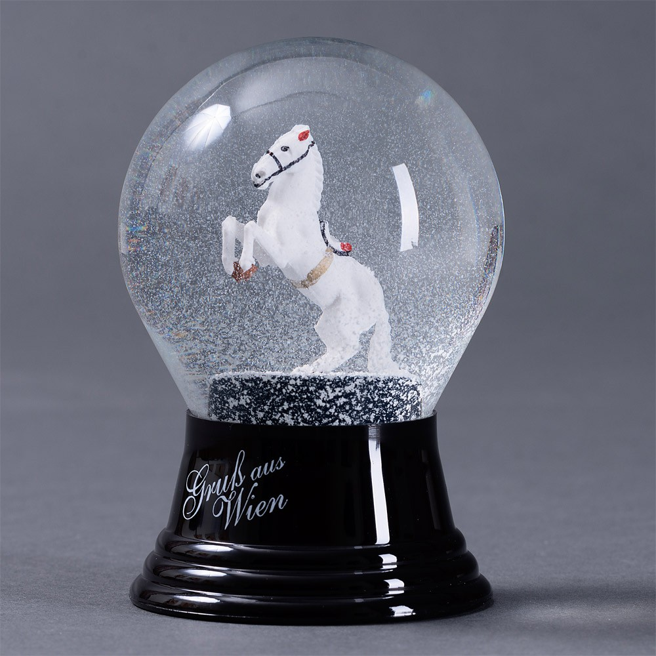
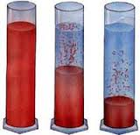
SUSPENSIONS
Is a mixture in which particles are large enough to settle out without being shaken, so they are usually settled down minutes after being stirred.

Slide 12
MIXTURES CAN BE SEPARATED BY PHYSICAL MEANS
MIXTURE SEPARATION TECHNIQUES

Slide 13
Mixtures can be separated according to the physical characteristics of their components.
HOMOGENEOUS MIXTURES | HETEROGENEOUS MIXTURES
DISTILLATION | FILTERING
EVAPORATION | SIEVING
CHROMATOGRAPHY | DECANTATION (SEDIMENTATION)
CRYSTALIZATION | CENTRIFUGATION
EXTRACTION | MAGNETIC SEPARATION

Slide 14
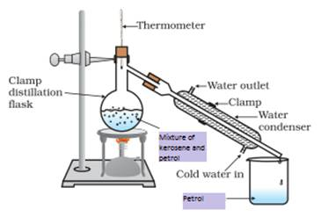
DISTILLATION
Used to separate liquids with different boiling point. Inside of the condenser, the liquid with the lowest boiling point, evaporates, and then, is condensed or turned back into liquid.

Slide 15
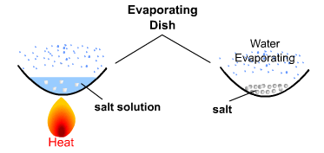
EVAPORATION
Used to separate miscible solids from liquids through the evaporation of the liquid.

Slide 16
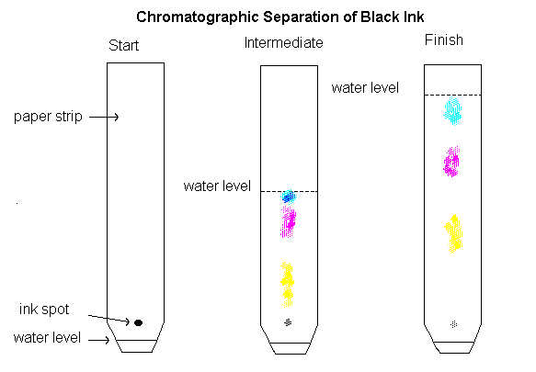
CHROMATOGRAPHY
Used to separate liquids with different solubility. The most soluble substances of the solute will run up the paper (mobile phase), and the solvent will stay as a stationary phase.

Slide 17
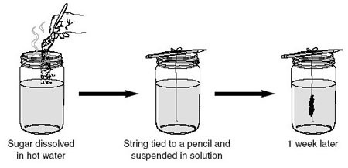
CRYSTALLIZATION
As evaporation, is used to separate miscible solids from liquids in saturated solutions

Slide 18
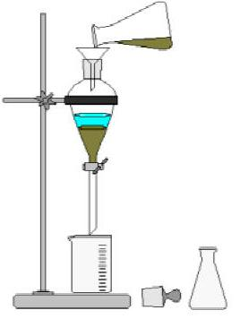
EXTRACTION
Is used to separate two substances that are not miscible.

Slide 19
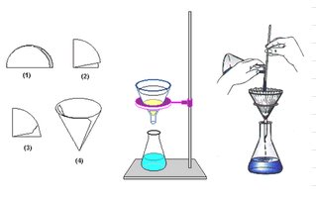
FILTRATION
It is used to separate solids that are not miscible in the solvent. For this, a filter paper or a porous material can be used to retain the solid particles.

Slide 20
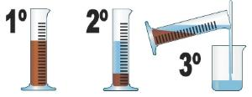
SEDIMENTATION (DECANTATION)
Is the mechanic separation of two substances in which the denser settles down in the container facilitating the extraction of the other.

Slide 21
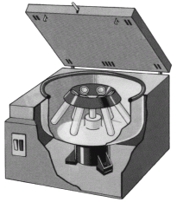
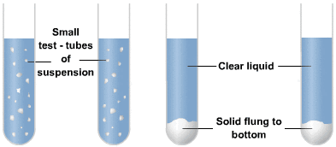
CENTRIFUGATION
Is a facilitated sedimentation by using a spinning machine called a centrifuge that uses the physical forces to precipitate the denser substances faster.

Slide 22
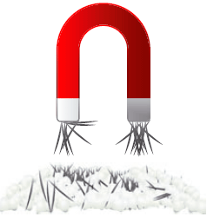
MAGNETIC SEPARATION
Is used to separate iron from other substances by using a magnet right above the mixture.

Slide 23
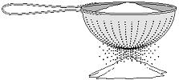
SIEVEING
Is a technique that includes colanders or sieves with different calibres located in decreasing order to retain the particles of different sizes as the mixture passes through them.

