Slide 1
BONE INJURIES
When fundaments fail…

Slide 2
https://www.youtube.com/watch?t=255&v=OyK0oE5rwFY

Slide 3
BURSITIS
The bursa is a sac filled with lubricating fluid called hyaline liquid, located between tissues such as bone, muscle, tendons, and skin, that decreases rubbing, friction, and irritation.
Bursitis is the inflammation of the bursa. It is most often caused by repetitive, minor impact on the area, or from a sudden, more serious injury.

Slide 4
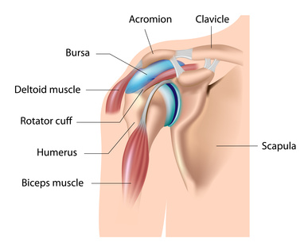
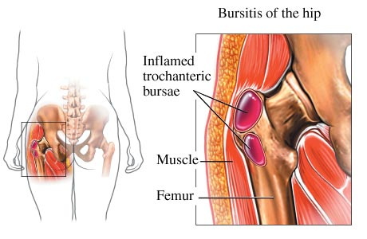
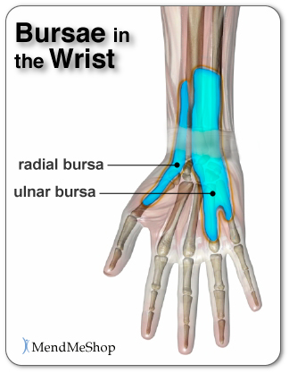
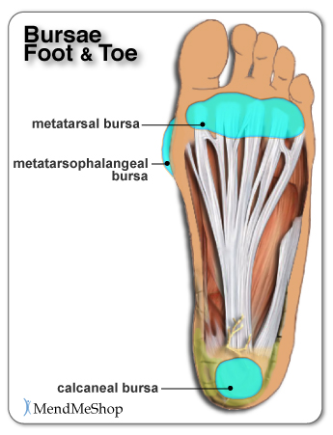
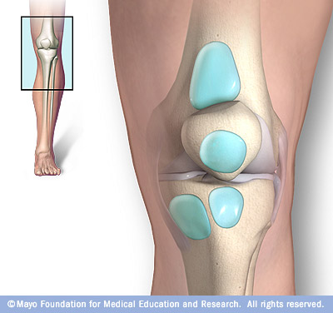
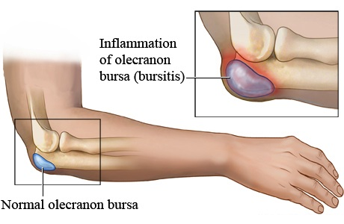

Slide 5
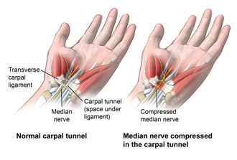
CARPAL TUNNEL SYNDROME

Slide 6
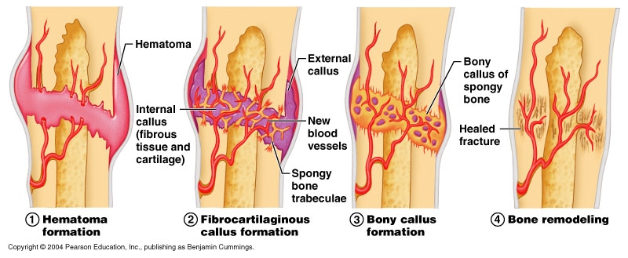
FRACTURES
Fractures occur when after a bump, a bone breaks in two or more parts. For a bone to heal, it is important to keep its parts aligned together.

Slide 7
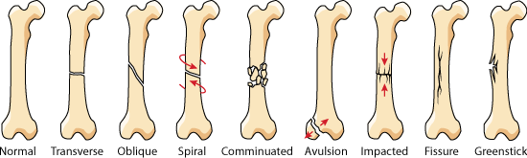
TYPES OF FRACTURES

Slide 8
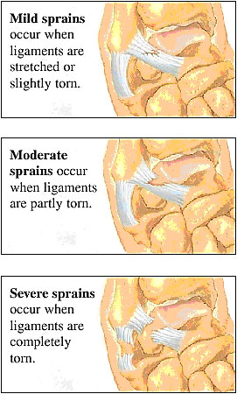
SPRAINS
Sprains occur when ligaments break because of overweight or an incorrect movement.

Slide 9
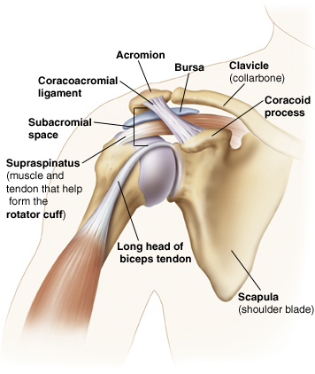
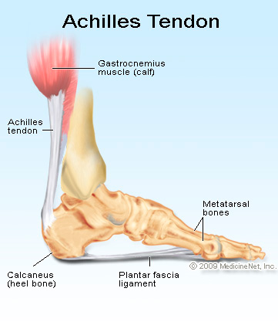
TENDON RUPTURE

Slide 10
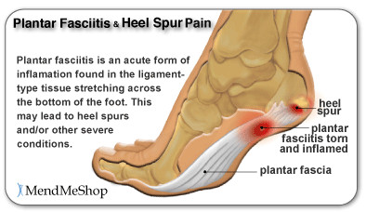
FASCIITIS

Slide 11
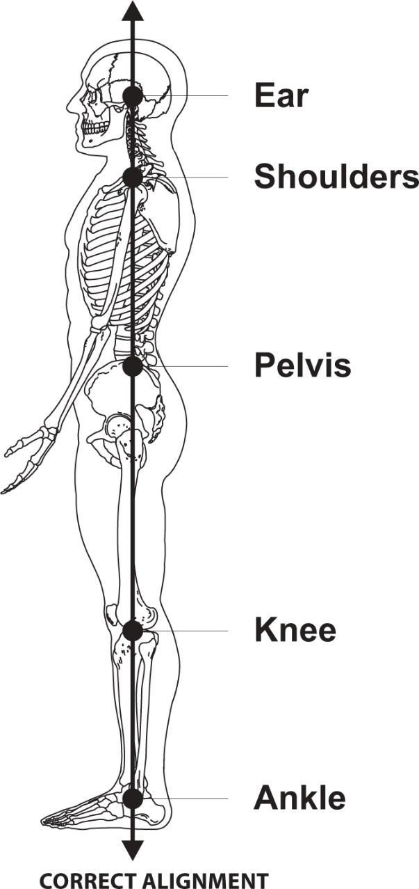
WHAT POSTURE SAYS ABOUT YOU
Believe it or not, your posture shows your mode and talks about your personality.
A good posture shows a confident person ready to take on the world and embrace life.
bodybuilding.com/fun/posture-power-how-to-correct-your-body-alignment.html
embodypilates.wordpress.com/2014/05/29/what-posture-type-are-you/

Slide 12
It’s not only about “looking good”, it’s about feeling good.
Welfare and self-esteem are important to have a healthy body, so each time you seem to be with your head down, hunched backs and imbalanced hips, you’d better look at what’s wrong with you.

Slide 13
An improper posture can lead to:
Chronic back, neck, and shoulder pain
Foot, knee, hip, and back injuries
Headaches
Stiffness
Fatigue
Muscle atrophy and weakness
Difficulty breathing
Digestion issues
Impingement and nerve compression
Sciatica
Carpal tunnel syndrome

Slide 14
BODY ALIGNMENT
Most postural deviations occur because the muscles that work to hold a joint in place are imbalanced. Generally speaking, one muscle group will be too tight and the opposing muscle group will be too loose or weak.
When imbalances like these occur, overactive muscles compensate for underactive muscles, which causes tension, fatigue, and discomfort.

Slide 15
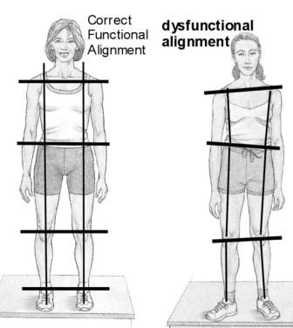
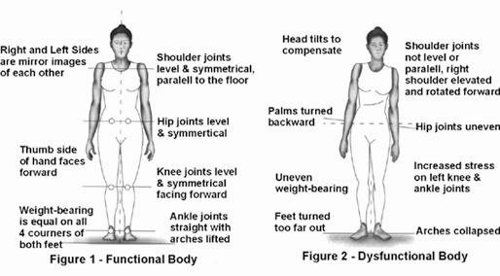
The easiest and most effective way to correct imbalances is to stretch the overactive muscles and to strengthen the underactive muscles.

Slide 16
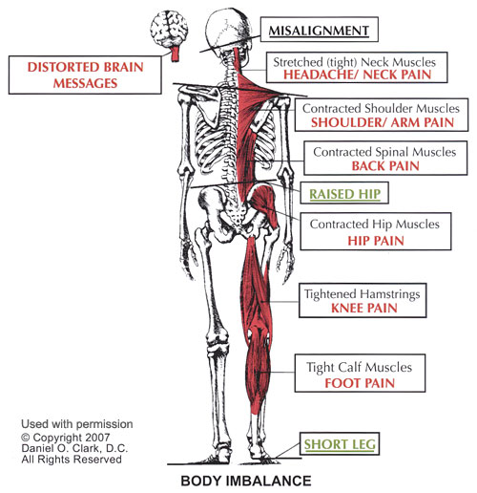

Slide 17
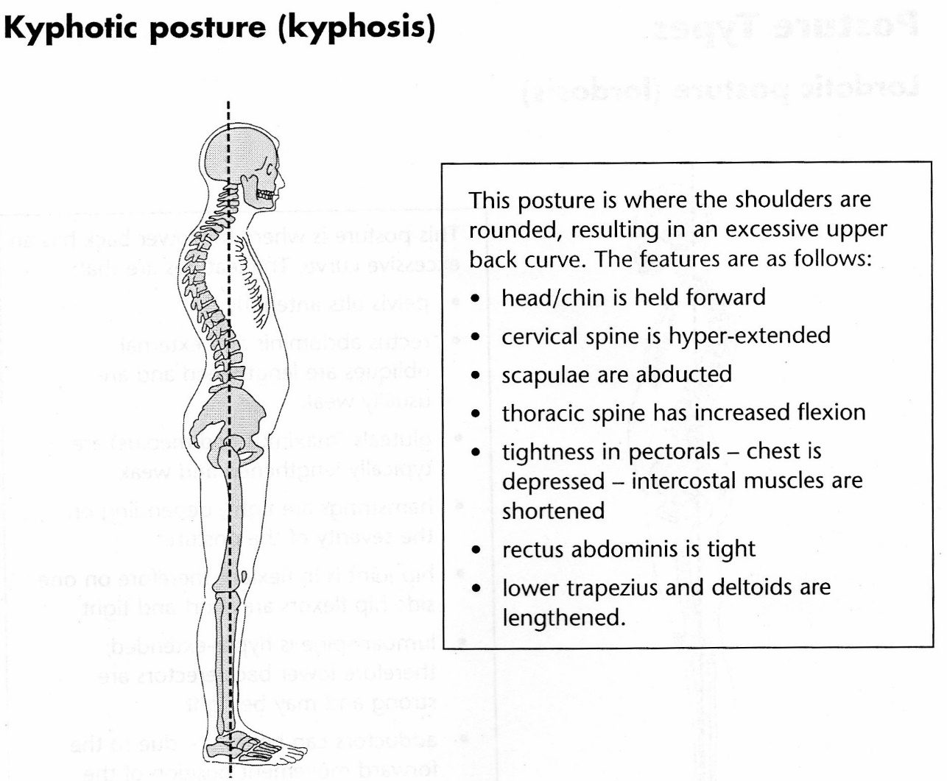
It is common in:
Office workers
Obese people
Large breasted women
Very tall people

Slide 18
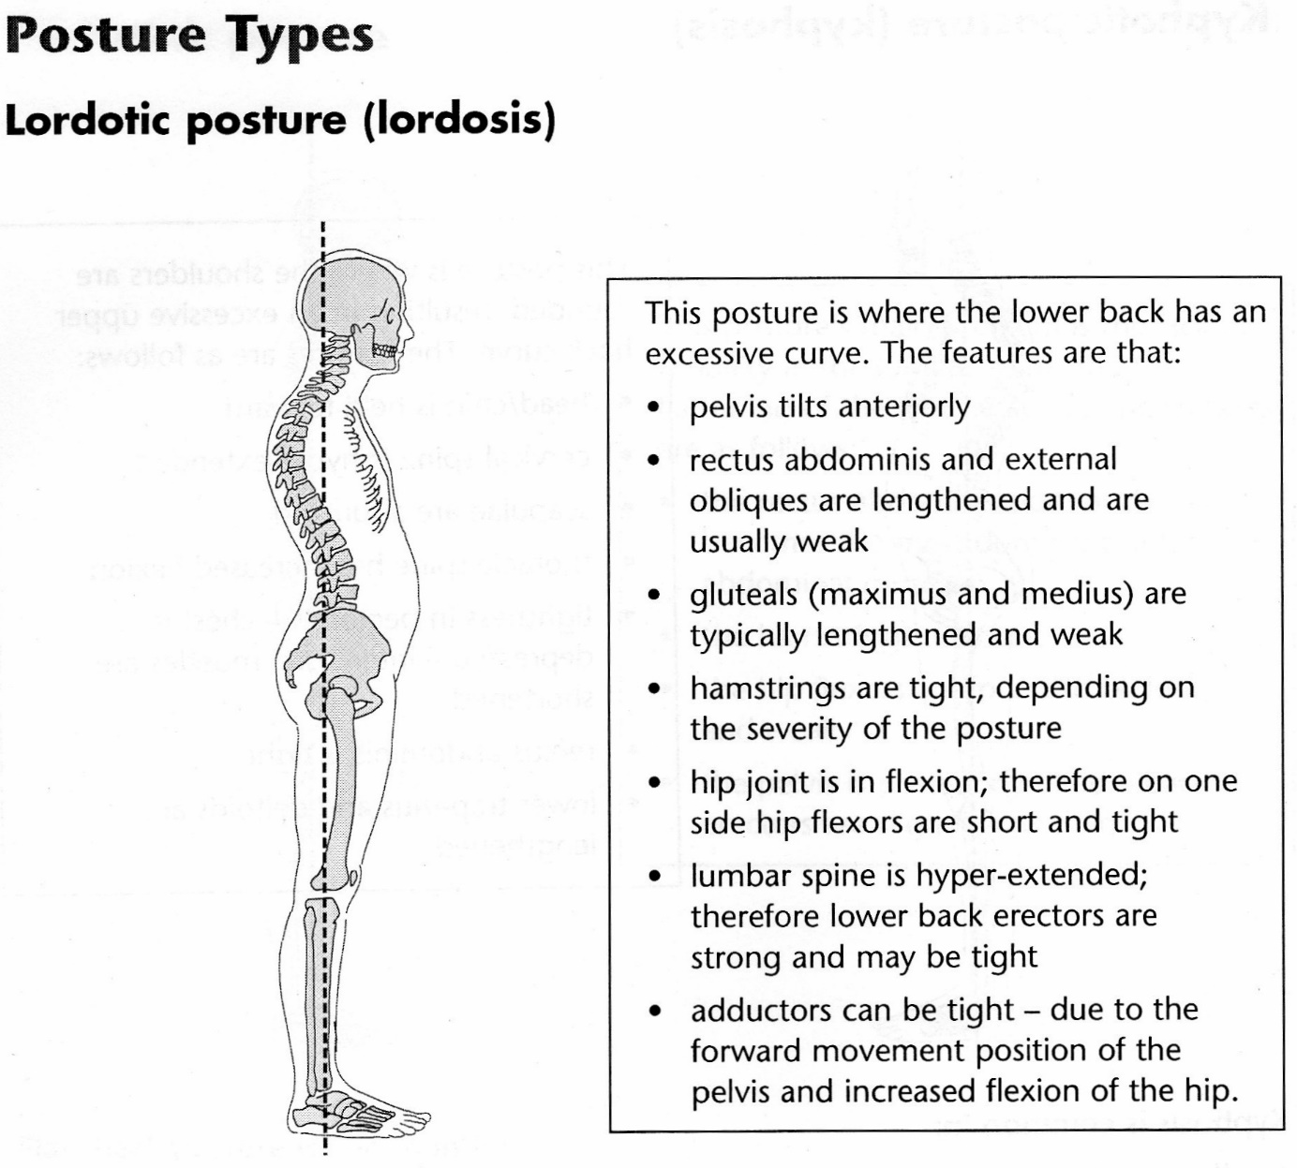
It is common in:
Dancers
Pregnant women
Obese people
Gymnast
Sports people exposed to repeated lumbar extension

Slide 19
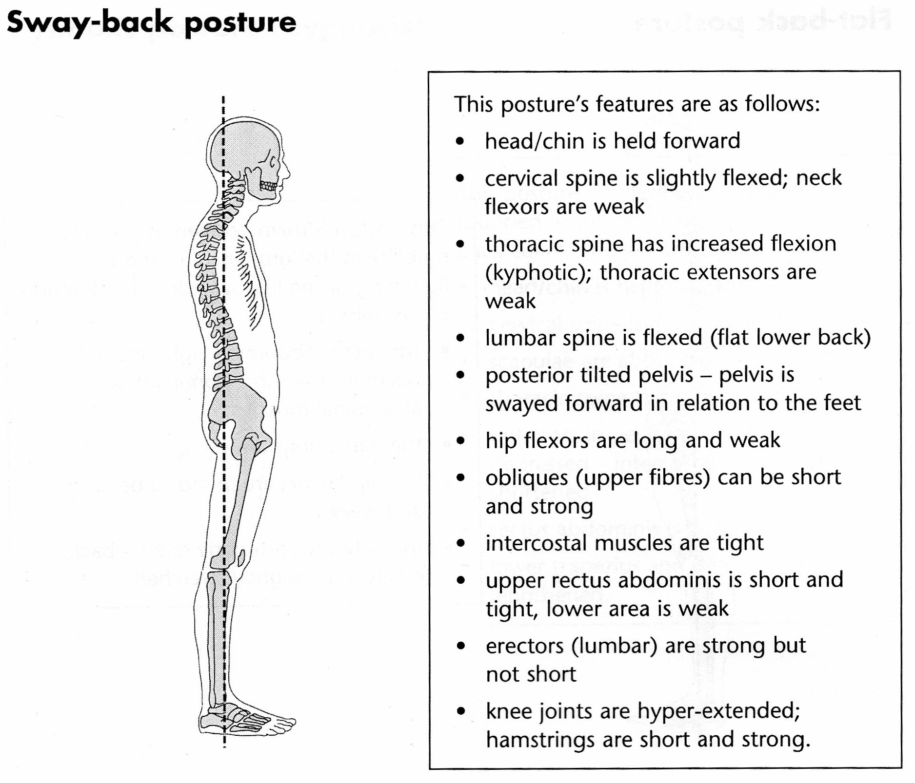
It is common in:
Teenagers
People who is standing for a long time

Slide 20
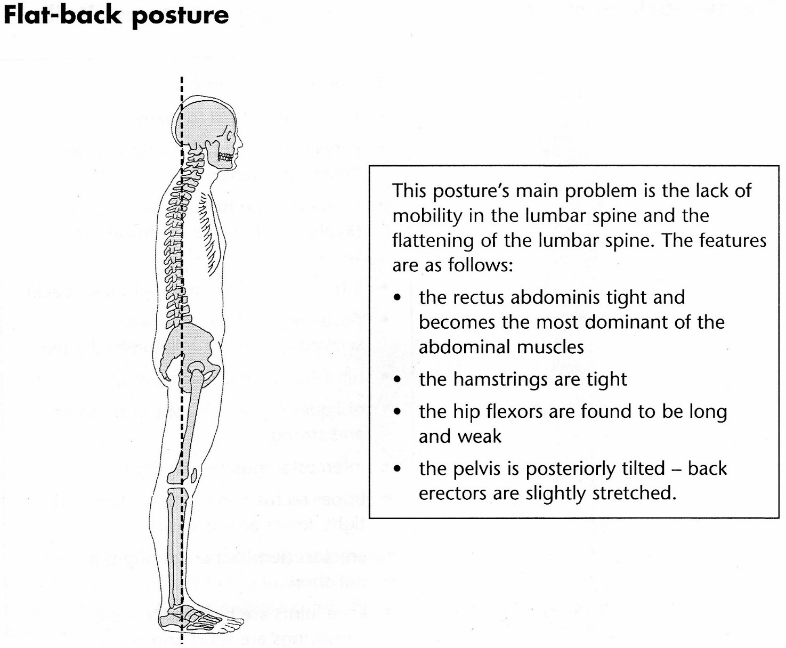
It is common in:
Boxers
People with poor core and back stability
People who practice “sit-up” exercises.

Slide 21
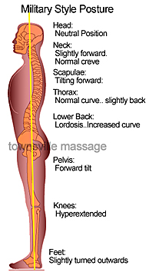
Military type posture is often seen and is characterized by the chest being pushed forward and an increased lumbar curve, resulting in short, tight hip flexors and lower back muscles, and weak, lengthened hamstrings and abdominal muscles…

Slide 22
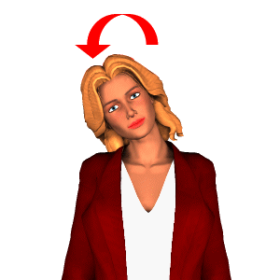

HEAD TILT
HEAD TILTED TO ONE SIDE; CAN BE ACCOMPANIED BY ROTATION TOWARD THAT SIDE

Slide 23
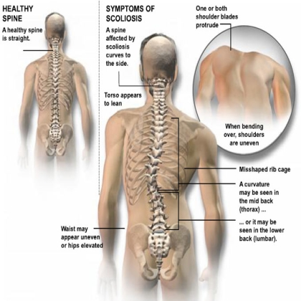
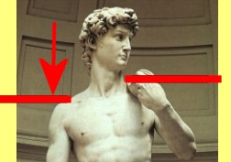
UNEVEN SHOULDERS
ONE SHOULDER SITS HIGHER THAN THE OTHER

Slide 24
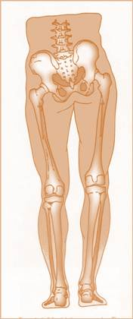
UNEVEN HIPS
ONE HIP SITS HIGHER, CAN GIVE THE PERCEPTION OF LEG LENGTH DISCREPANCY

Slide 25
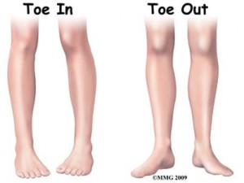
FEET TURNED IN or out
TOES ARE TURNED IN TOWARD THE MIDLINE OF THE BODY
TOES ARE TURNED OUT AWAY FROM THE MIDLINE OF THE BODY

Slide 26
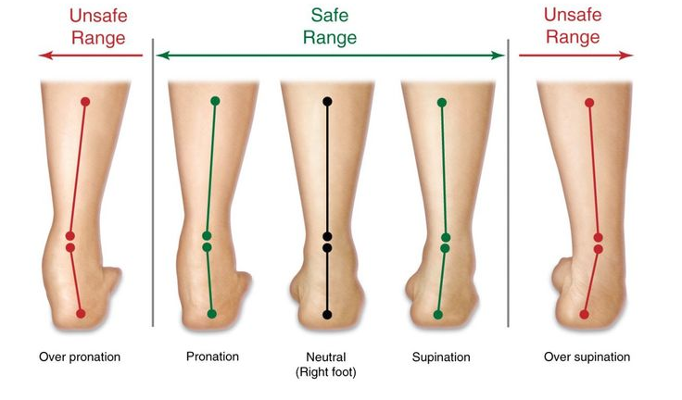

Slide 27
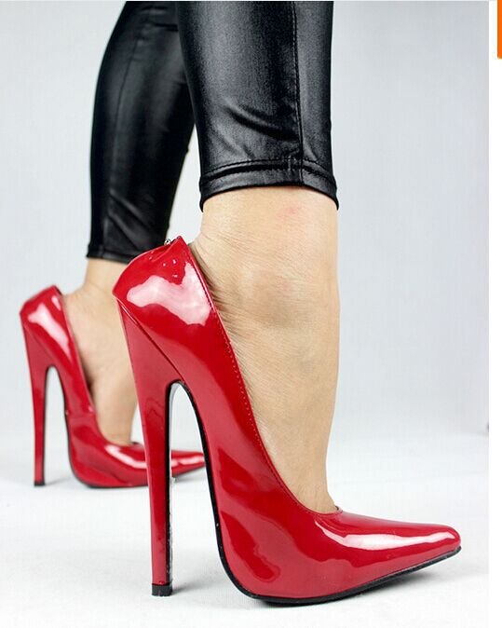
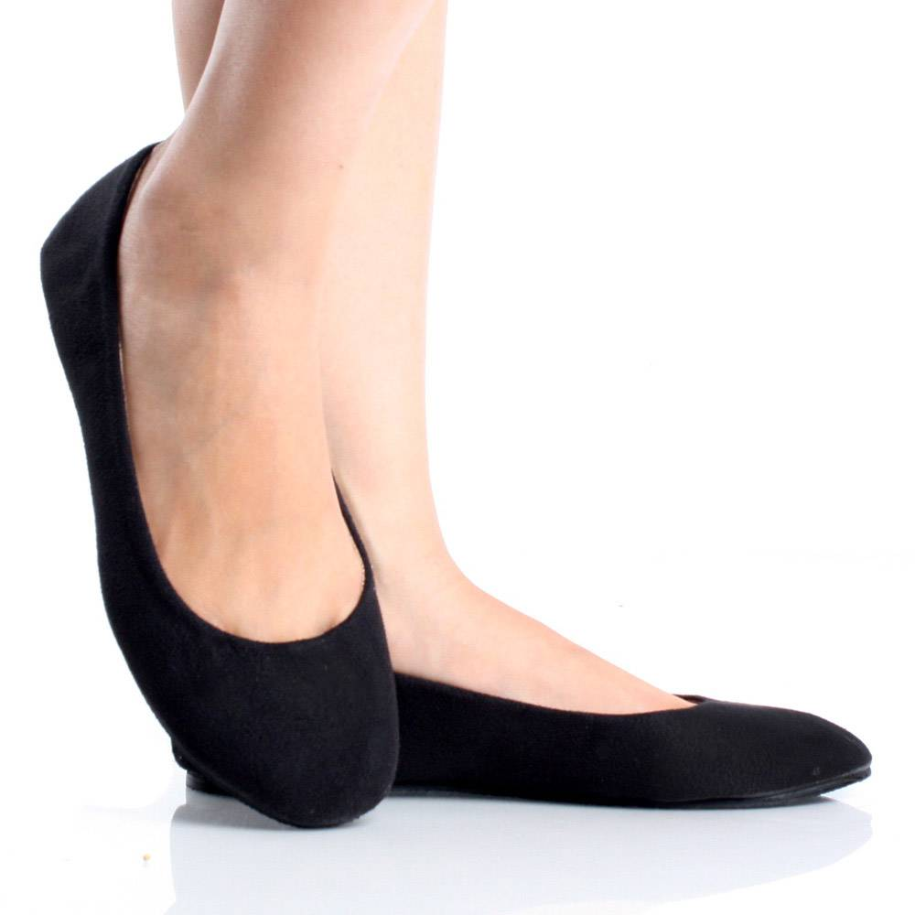
THE RIGHT SHOES

Slide 28
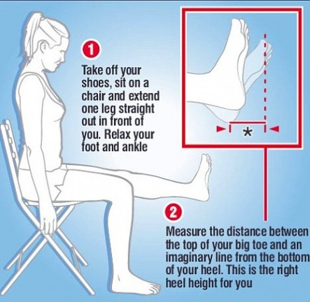
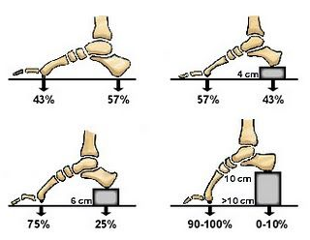

Slide 29
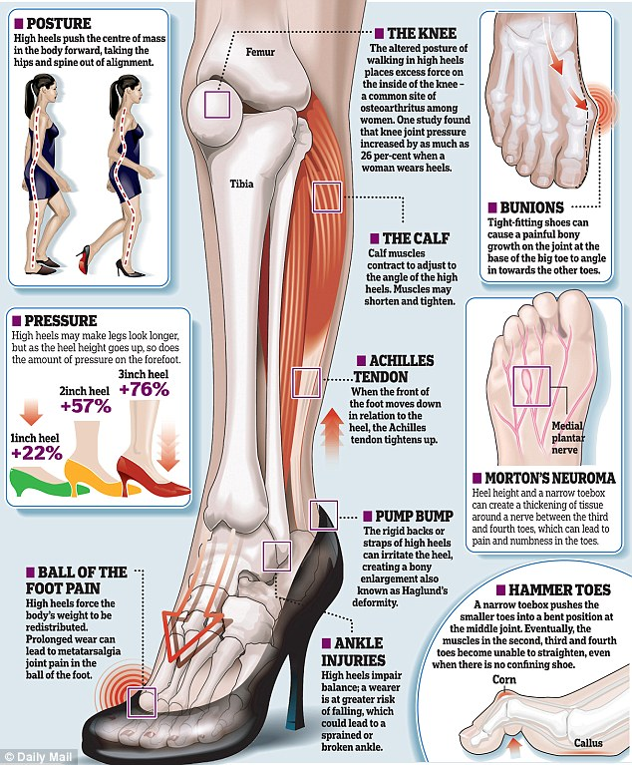
Heels are beautiful, but try not to use them all time. If you have to, just find a moment to stretch your feet and legs in order to relax your bones and muscles.
Even, some sports shoes can harm your feet, so if you practice some port, with special shoes, don’t forget to stretch and relax.

Slide 30
